Slide 1
Accelerators
Example: video accelerator

Slide 2
Concept
Build accelerator for block motion estimation, one step in video compression.
Perform two-dimensional correlation:
Frame 1
f2
f2
f2
f2
f2
f2
f2
f2
f2
f2

Slide 3
Block motion estimation
MPEG divides frame into 16 x 16 macroblocks for motion estimation.
Search for best match within a search range.
Measure similarity with sum-of-absolute-differences (SAD):
  Σ | M(i,j) - S(i-o_{x}, j-o_{y}) |

Slide 4
Best match
Best match produces motion vector for motion block:

Slide 5
Full search algorithm
bestx = 0; besty = 0;
bestsad = MAXSAD;
for (ox = - SEARCHSIZE; ox < SEARCHSIZE; ox++) {
for (oy = -SEARCHSIZE; oy < SEARCHSIZE; oy++) {
int result = 0;
for (i=0; i<MBSIZE; i++) {
for (j=0; j<MBSIZE; j++) {
result += iabs(mb[i][j] - search[i-ox+XCENTER][j-oy-YCENTER]);

Slide 6
Full search algorithm, cont’d.
}
}
if (result <= bestsad) { bestsad = result; bestx = ox; besty = oy; }
}
}

Slide 7
Computational requirements
Let MBSIZE = 16, SEARCHSIZE = 8.
Search area is 8 + 8 + 1 in each dimension.
Must perform:
  n_{ops} = (16 x 16) x (17 x 17) = 73984 ops
CIF format has 352 x 288 pixels -> 22 x 18 macroblocks.

Slide 8
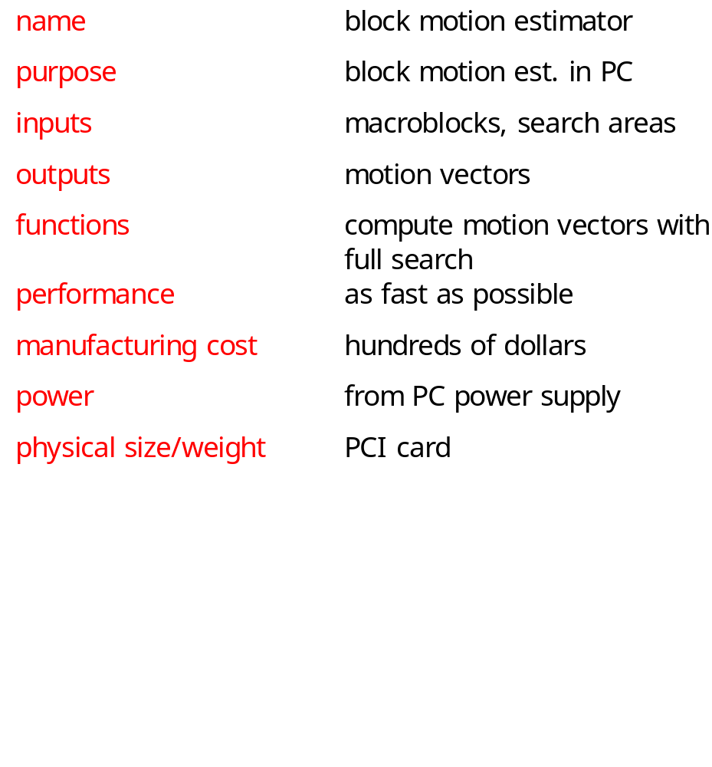
Accelerator requirements

Slide 9
Accelerator data types, basic classes
Motion-vector
Macroblock
Search-area
x, y : pos
pixels[] : pixelval
pixels[] : pixelval
PC
Motion-estimator
memory[]
compute-mv()

Slide 10
Sequence diagram
:PC
:Motion-estimator
compute-mv()
Search area
memory[]
memory[]
macroblocks
memory[]

Slide 11
Architectural considerations
Requires large amount of memory:
  macroblock has 256 pixels;
  search area has 1,089 pixels.
May need external memory (especially if buffering multiple macroblocks/search areas).

Slide 12
Motion estimator organization
PE 0
search area
network
PE 1
comparator
Address
generator
ctrl
...
Motion
vector
macroblock
network
PE 15

Slide 13
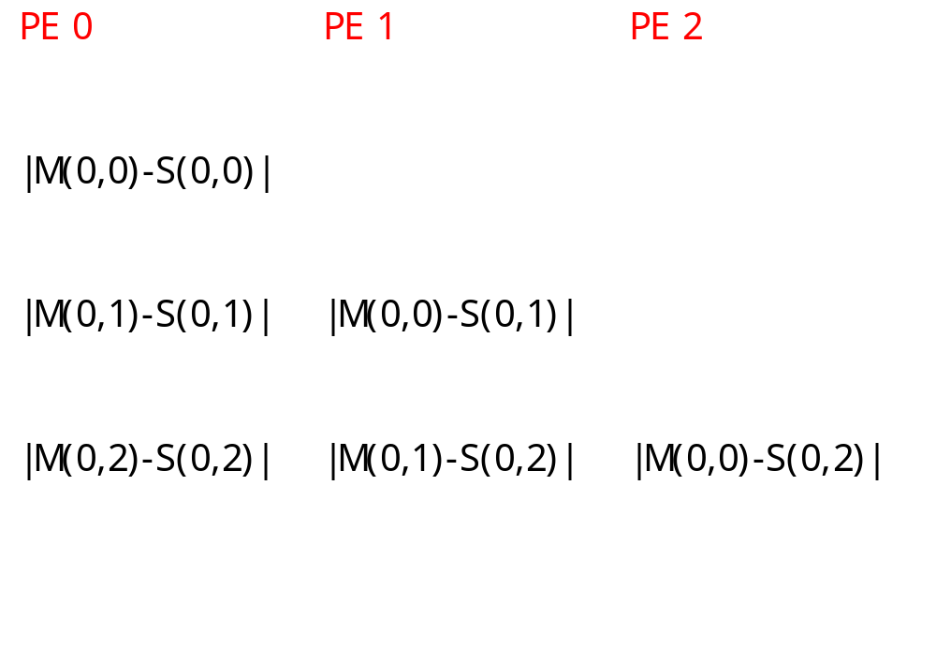
Pixel schedules
M(0,0)
S(0,2)

Slide 14
System testing
Testing requires a large amount of data.
Use simple patterns with obvious answers for initial tests.
Extract sample data from JPEG pictures for more realistic tests.

